Slide 1
Graduation & College Entrance Requirements
Graduation Requirements
English-40 credits
Social Science-40 credits
Mathematics-20 credits
Science-30 credits
Fine Arts/Foreign Language/CTE-10 credits
Physical Education-20 credits
Electives-60 credits
Total credits for graduation-220
Pass NETS 5 and 6
A-G Requirements
A. History/Social Science-2 Years
B. English-4 years
C. Mathematics-3 years
D. Laboratory Science-2 years
E. Foreign Language-2 years
F. Visual and Performing Arts-1 year
G. College Preparatory Electives- 1 year
*Must complete all A-G classes with a “C” or better.

Slide 2
The 22 required classes
1. English 1
2. English 2
3. English 3
4. English 4
5. Geography/Health
6. World History
7. US History
8. Government/Econ
9. Integ Math 1 or higher
10. Integ Math 2 or higher
11. 1 Life Science
12. 1 Physical Science
13. 1 additional science
14. PE 1
15. PE 2
16. Fine art or Foreign Language or CTE course
17. Elective 1
18. Elective 2
19. Elective 3
20. Elective 4
21. Elective 5
22. Elective 6

Slide 3
It’s Important to Pass Every Class On The First Try
Summer School is limited
Failing classes could lead to placement at an alternative site
You may have to stay after school or lose electives in order to make up classes you failed

Slide 4
It’s Important to Get Good Grades
You could qualify for college
You will be eligible for athletics and other activities
You will earn your diploma!
You can earn extended lunch!!

Slide 5
How can I earn extended lunch?
At the end of the semester (Dec 15th) have a GPA of 2.0 with no D’s or F’s
or
At the end of the semester have a GPA of 2.6 or higher with only one D

Slide 6
How Can I See my Counselor?
Counselors are located in H10 and B6
Your counselor is based on your last name or the special program you are in.
A-Gomez = Mrs. Powell H10
Gonzales-Perez = Mr. Lawler H10
Perf-Sh, Engineering and IB = Mrs. Rodriguez B6
Si-Z and AVID = Mrs. Sousa B6
You can see your counselor before school, at breaks, at lunch or after school. You should not go to your counselor during class time without a pass.
If your counselor is unavailable when you come by fill out a “Request to See Counselor” form and leave it in the box outside your counselor’s door.

Slide 7
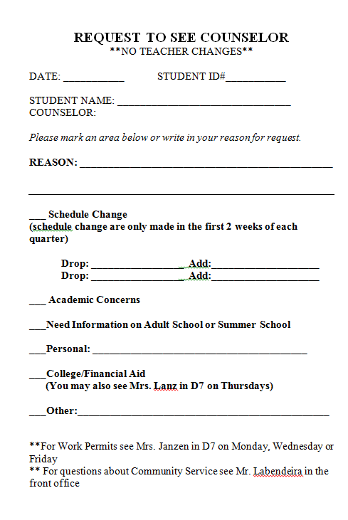

Slide 8
Questions?

